Slide 1

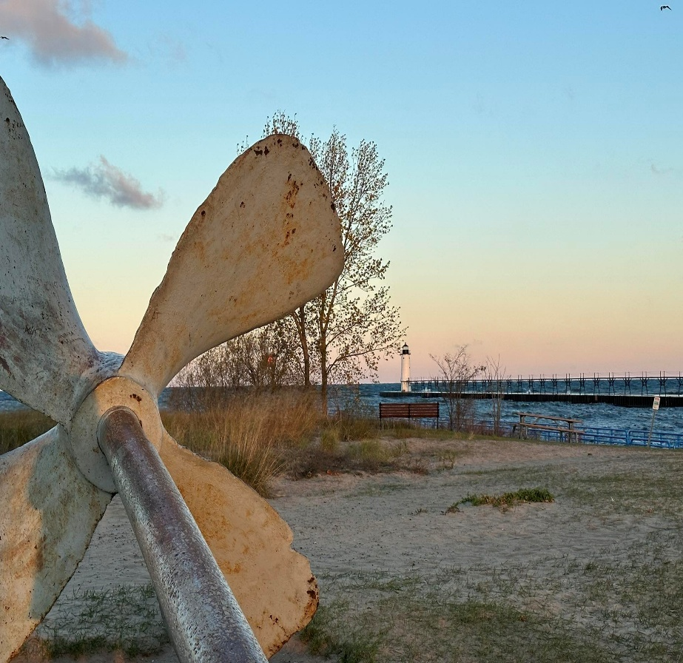

MANISTEE COUNTY
2024-2025
ANNUAL REPORT
Phone: 231.889.4277
Website: https://www.canr.msu.edu/manistee/
Email: msue.manistee@county.msu.edu
          I’m excited to share the results of another successful year of partnership between Manistee County and
    Michigan State University (MSU) Extension. Thanks to your ongoing support, we’ve been able to make a meaningful impact on the lives of youth, families, businesses, and communities throughout the county.
MSU Extension continues to offer a wide array of research-based educational outreach to our residents. Over the past year, we’ve empowered individuals and families to lead healthier lives, supported local and new businesses, provided opportunities for youth leadership development and career exploration, assisted farmers with business management and mental health support, and so much more. Our team lives and works alongside county residents, building strong community relationships and staying responsive to local needs.
We remain committed to delivering our programs in personalized formats and locations that are convenient and accessible to our participants. This ongoing success is possible because of our strong partnership with you. On behalf of the MSU Extension team serving Manistee County, thank you for another outstanding year. We look forward to your continued support and hope you will join us in our upcoming programs.
Jennifer Berkey
District 3 Director
Message from the District Director
Impact
196
Programs accessed by residents
831
Reached through programming
38,811
Reached by social media
Helping people improve their lives through an educational process that applies knowledge to critical issues, needs and opportunities msue.msu.edu

Slide 2
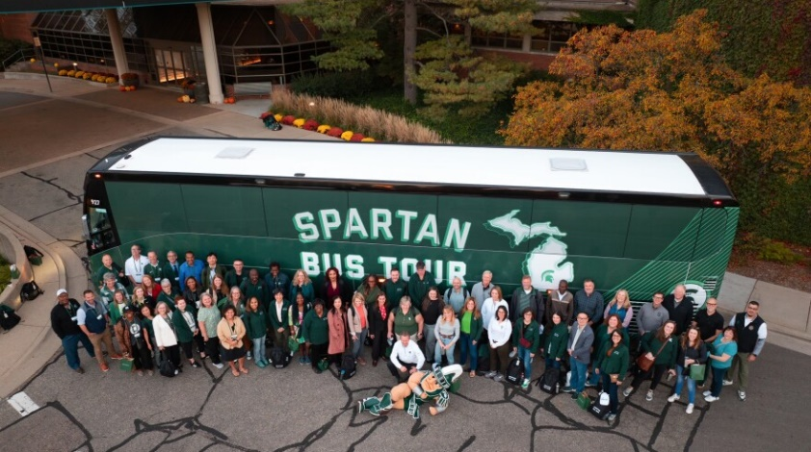
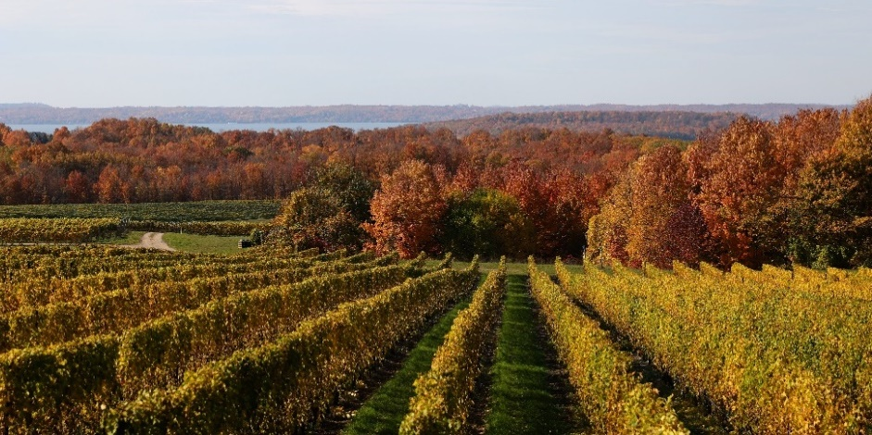
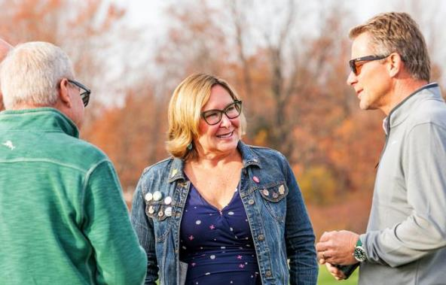
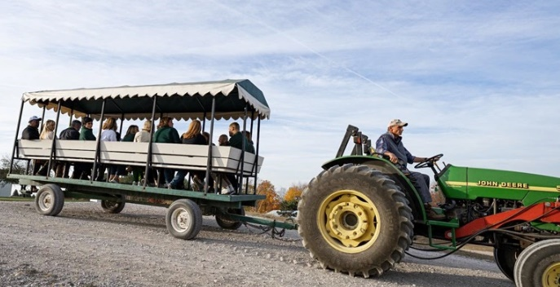

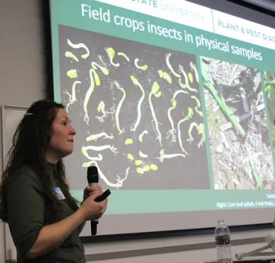

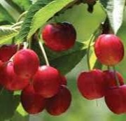
SUPPORTING AGRICULTURE AND AGRIBUSINESS
AGRICULTURE PROGRAM
NWMHRC BUS TOUR
The Northwest Michigan Horticultural Research Center (NWMHRC) was proud to be a stop on the inaugural Michigan State University Spartan Bus Tour on October 22, 2024. The tour was hosted by MSU President Kevin Guskiewicz, a neuroscientist and concussion research leader who joined MSU in March 2024. He came to us from the University of North Carolina, and in keeping with a tradition he started there, he hosted a bus trip through a slice of Michigan for 60 MSU faculty and staff.
NWMHRC was honored to be selected as a stop to share the latest in tree fruit research with the group.
Heather Leach led a lab tour and shared updates on the entomology research she is conducting in NW Michigan. Erin Lauwers, IPM Educator, led a wagon tour and explained various research trials that are going on in the field. Board members Mark Miezio and Bruce Veliquette offered valuable insights into the complexities of cherry production, helping connect visitors, many new to agriculture, with the region’s unique challenges. Both of our board members did a terrific job, and their messages were engaging, insightful, and delivered from the heart. Their information really resonated with the group, and there was a plethora of interesting and engaging questions from the audience.
Thanks to everyone who contributed to making our bus tour stop a success! It was a fantastic opportunity to share the impactful work happening in Northwest Michigan with the broader MSU community.
INTEGRATED PEST MANAGEMENT UPDATES
These updates feature timely discussions of pest challenges and management options dictated by weather and pest biology. Attendees are encouraged to bring examples of pests and damage found on the farm for identification and discussion. Additionally, we host invited speakers from local organizations and Michigan State University. Updates were held bi-weekly in Grand Traverse, Antrim and Benzie Counties. A virtual option was also available during Wednesday meetings.

Slide 3
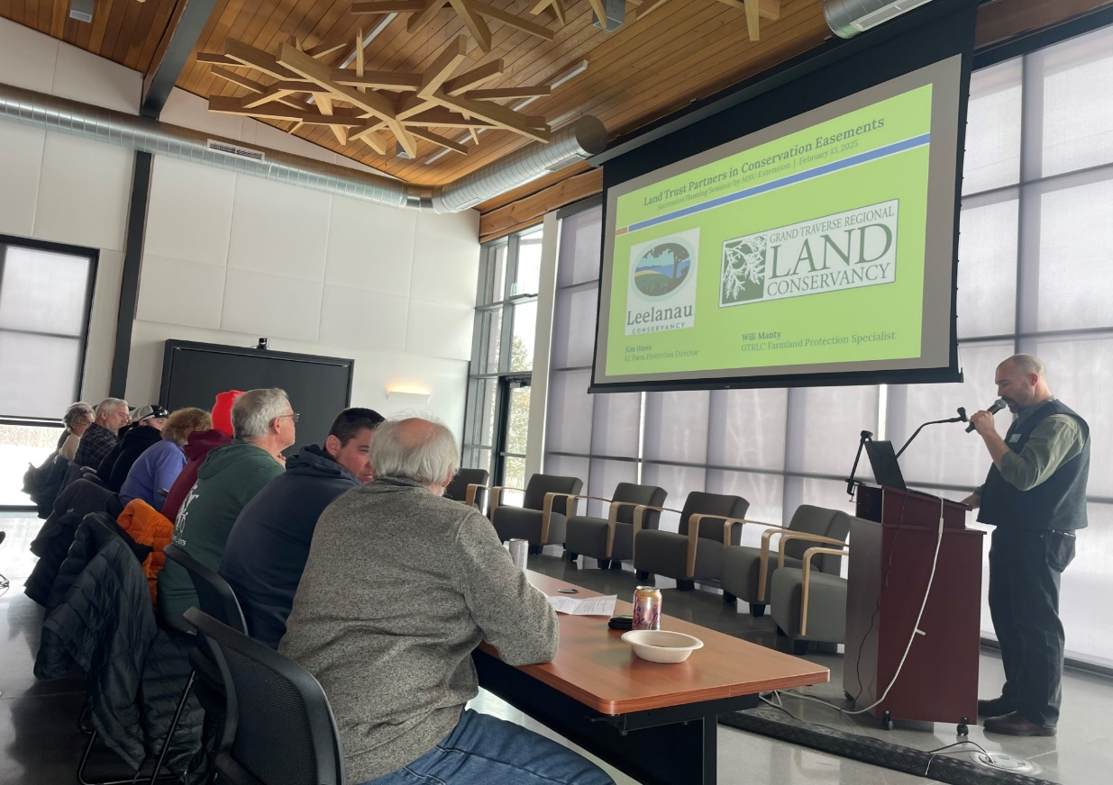
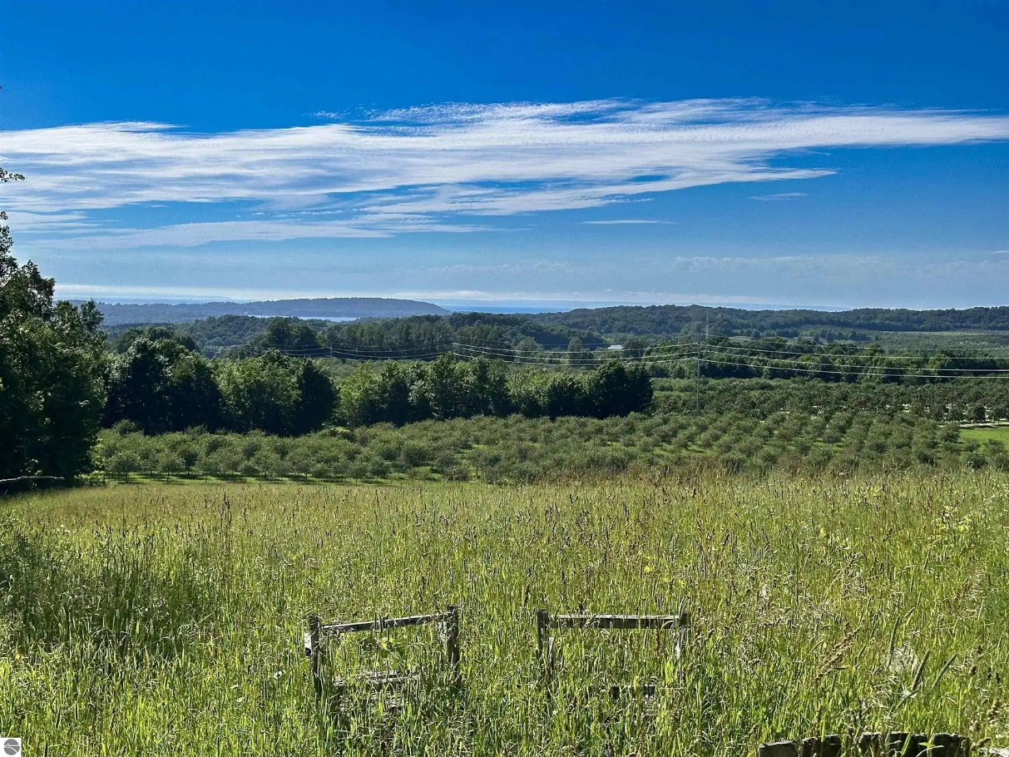
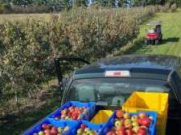
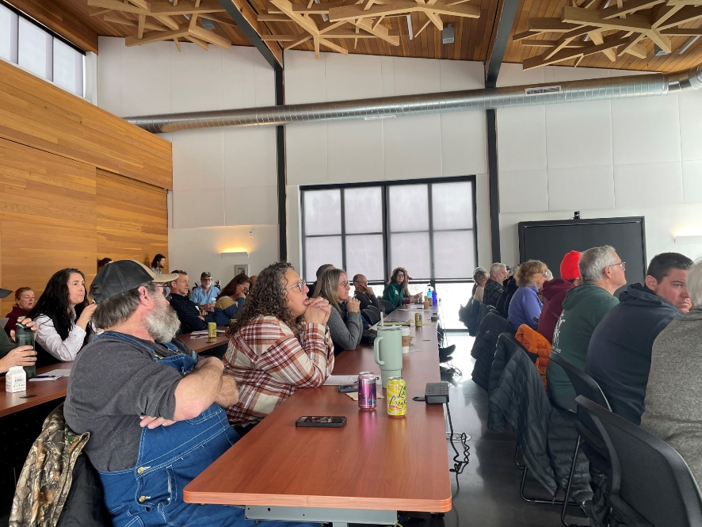


SUPPORTING AGRICULTURE AND AGRIBUSINESS
AGRICULTURE PROGRAM
Year-end tax estimate meetings provided farmers with the opportunity to save nearly $54,000, allowing for investment back into the farm business to help build farm resilience
FARM BUSINESS
MANAGEMENT
Farm Business Management Educator Chris Bardenhagen works with area farmers on succession planning, financial management, and cost of production budgeting – both at the individual level and across the broader industry. In 2024, Chris assisted nine area farms with Telfarm program outreach, helping to determine end-of-year tax strategies and annual balance sheet analysis. Farmers who participate in the program gain a greater understanding of their farm’s financial strengths and weaknesses, and how they can improve upon their financial standing.
These farms represent about $5 million in sales in 2024. Despite a challenging year for many farms, year-end tax estimate meetings provided farmers with the opportunity to save nearly $54,000. Strategizing on year-end taxes goes beyond saving money – it can also support investments and upgrades in equipment and infrastructure, boosting the farm’s long-term resilience.
Succession planning was another key focus this year. Chris worked closely with more than 10 families as they navigated important decisions about transferring their farms – a topic that continues to gain interest among producers. He also helped organize a well-attended seminar in partnership with Grand Traverse Regional Land Conservancy, drawing in more than 40 attendees. The workshop featured presentations on the structure of the planning process, legal instruments including trusts, and critical considerations necessary for advancing a farm succession plan. Related topics included the use of conservation easements in estate planning and the role of Michigan Farm Link in connecting land-seeking farmers with landowners. Succession planning tools and resources help farm families to make informed choices to successfully transfer business knowledge, responsibilities, and assets to the next generation of farmers.
In 2024, Chris also continued work on cost of production studies that provide tools to area growers. This year work was done to develop cost budgets for peaches, apples, and blueberries, and work began on a new
cost study for chestnut – a promising crop for former tart cherry sites.
Through his efforts, Chris provides essential resources that help farmers strengthen their businesses, plan for the future, and remain competitive in a rapidly evolving agricultural landscape.
9 area farms representing nearly
$5 million in revenue in 2024

Slide 4
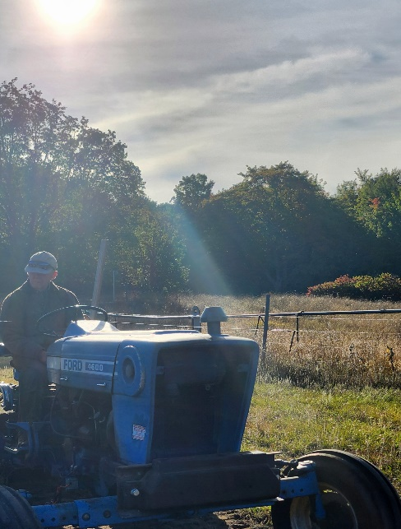
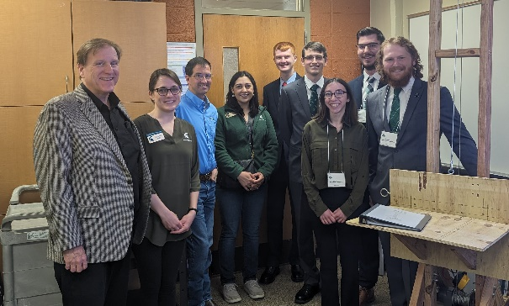
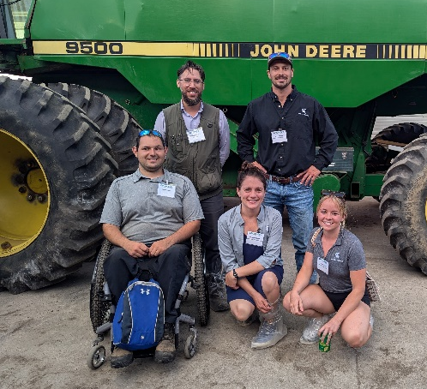

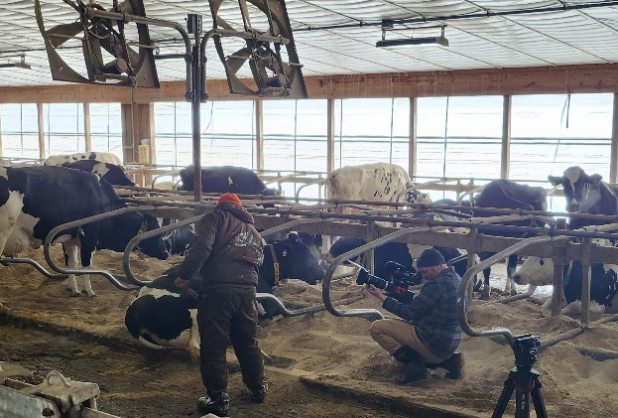


SUPPORTING AGRICULTURE AND AGRIBUSINESS
AGRICULTURE PROGRAM
2024 saw an increase of 1,130 Farm Stress participants, representing a 131% increase
FARM STRESS & AGRABILITY
Michigan AgrAbility empowers individuals in the agricultural industry to continue working despite injury, illness, or disability. The program’s mission is to enhance quality of life for farmers, ranchers, and other agricultural workers with disabilities, so that they, their families, and their communities continue to succeed in rural America. In 2024, the program served 212 clients and reached 7,725 people through workshops and trainings, with 428 direct interactions across the state.
Michigan Rehabilitation Services (MRS) supported clients by providing $368,590 in funding for assistive technology projects, benefiting 23 farm clients. Community partnerships also played a vital role—Alpha Gamma Rho’s (AGR) Tau Chapter at MSU contributed $37,000 in 2024, surpassing $150,000 in total donations since 2013. The February Beef Preview event continues to be a major fundraiser, directly supporting technology solutions for small farms and independent growers.
AgrAbility also collaborated with MSU’s College of Engineering for Design Day. In Spring 2024, students created a portable swarm trap hive lifter for a disabled veteran beekeeper and Heroes to Hives instructor. In the fall, they developed a mechanized kneeler cart for a client with severe foot pain to tend rows of low growing plants, which won the Edison Award for Best Design Project. Free downloadable design plans for both projects are available at www.canr.msu.edu/agrability.
In July, AgrAbility hosted a Regional Training Workshop in Ann Arbor with national staff and 44 participants from across the U.S. and beyond. This hands-on event strengthened the broader AgrAbility network and promoted greater understanding of assistive technology in agriculture.
Managing Farm Stress at MSU Extension
Farming is inherently demanding. From job-related injuries to volatile commodity prices, Michigan’s agricultural community faces significant stress. Whether stemming from financial pressures or everyday hardships, MSU Extension is here to help.
In 2024, our Managing Farm Stress team delivered 45 programs reaching 1,992 people—more than double any year outside of 2023. This marks a 131% increase from 2022, highlighting the program’s growing reach and effectiveness.
A major milestone this year was the creation of the MSU Farm Stress Endowment, approved by the Board of Trustees in December 2024. With seed funding from Cherry Republic, this endowment ensures long-term support for Michigan’s agricultural community.
We also continue to offer free counseling with farm-informed therapists and financial assistance for those in Michigan Agriculture, Forestry, and Fisheries. Learn more or access support at: https://www.canr.msu.edu/managing_farm_stress/teletherapy-program
Farming is tough, but you don’t have to do it alone. MSU Extension stands by our farmers and is ready to support you.
Managing Farm Stress
Managing Farm Stress
45 programs
1,992 participants

Slide 5
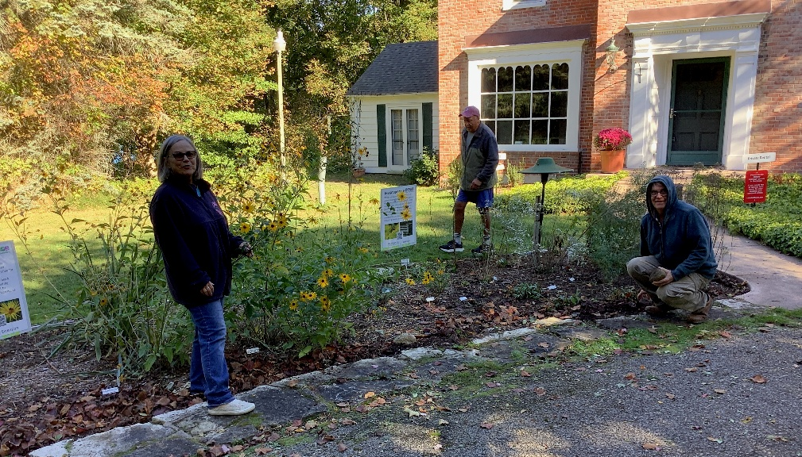
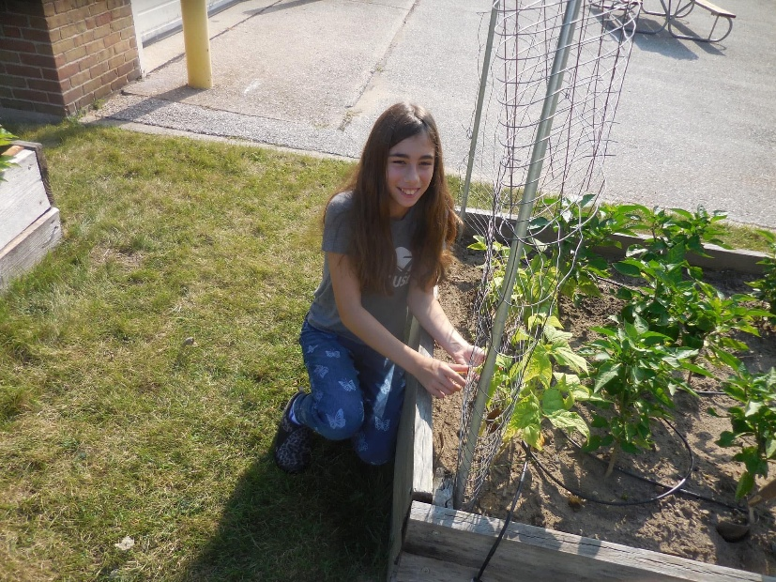
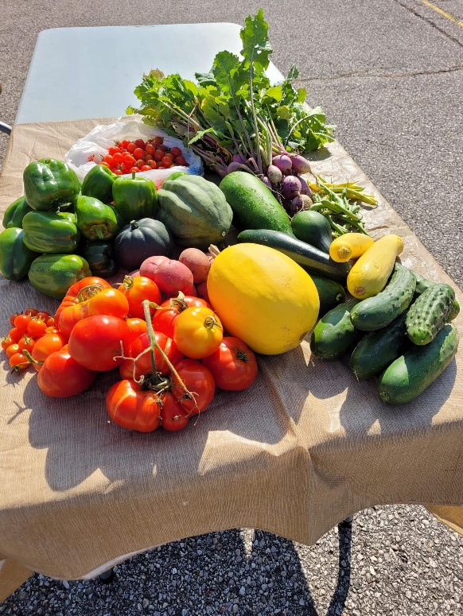
SUPPORTING AGRICULTURE AND AGRIBUSINESS
AGRICULTURE PROGRAM
96 Extension Master Gardener Hours volunteered, valued at $3,215
These hours were dedicated to educating residents and preserving the natural resources of Manistee County.
EXTENSION
MASTER GARDENER
This year, through volunteer outreach, MSU Extension Master Gardeners continued to share science-based gardening knowledge, engaged citizens, and empowered communities in environmentally responsible gardening practices.
In 2024, MSU Extension Master Gardeners volunteered for 96 hours in Manistee County, a time contribution valued at $3,215. MSU Extension Master Gardener volunteer activities impacted county residents by improving quality of life, empowering youth, protecting water quality, creating habitat for pollinators, and improving food security.
For example, MSU Extension Master Gardener Volunteers worked tirelessly to improve Manistee residents’ access to healthy food last year at the Sophia St. Community Garden and the Armory Youth Project.
Community members participating in these projects received gardening education as well as access to free produce, herbs, and cut flowers. In addition, the Armory Youth Project garden generated 251 pounds of fresh produce that was donated to area food pantries.
In another highlight from 2024, MSU Extension Master Gardener volunteers hosted a Smart Gardening education booth at the Manistee Conservation District’s seed swap event at the Manistee County Library. Attendees of the seed swap received free educational handouts on a variety of horticulture techniques that are designed to improve vegetable production and reduce the environmental impact of landscape and garden activities.
At Lake Bluff Farms, MSU Extension Master Gardeners installed pollinator habitat gardens on the grounds that include signs that educate the public
about the importance of native flowering plants for pollinators and other wildlife.

Slide 6
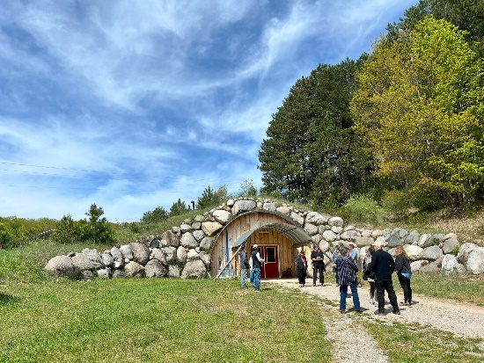
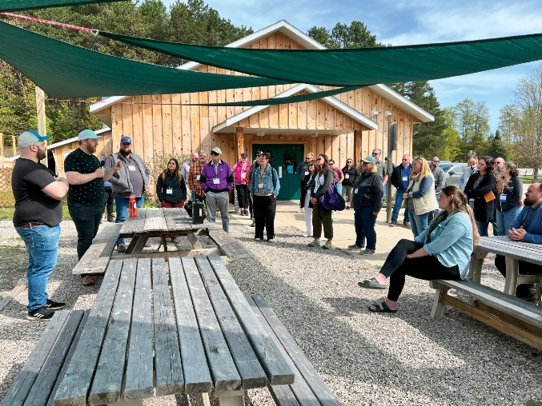

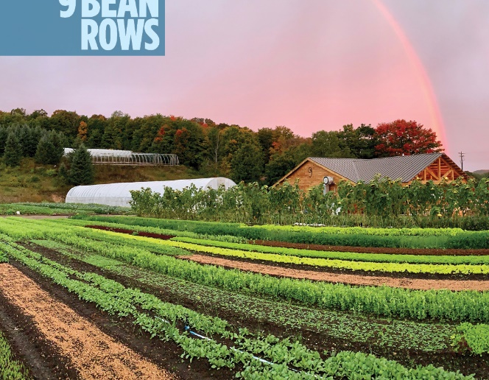
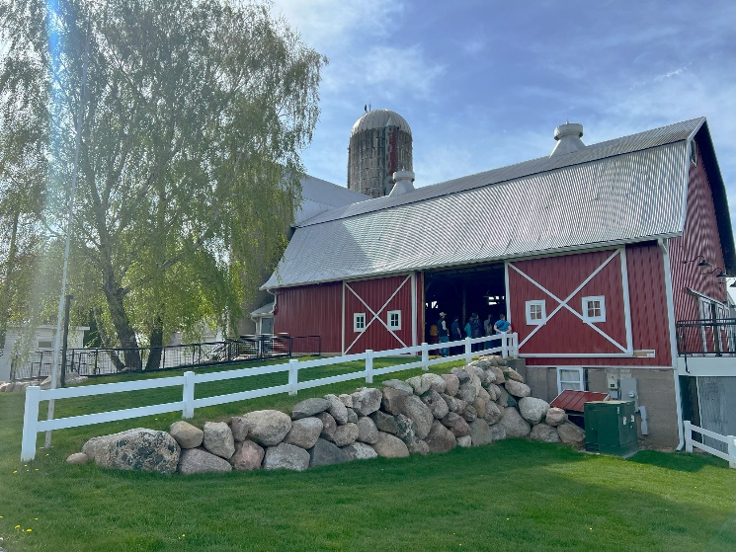

FOSTERING STRONG COMMUNITIES
AGRITOURISM
“This was a phenomenal summit. The organizers did a great job of bringing so many voices and perspectives to the table from many key facets of this multidimensional industry.”
-Agritourism Summit attendee
AGRITOURISM SUMMIT
MSU Extension, in partnership with local leaders, proudly hosted the first-ever Agritourism Summit on May 7 – 8, 2024. This exciting event brought together farmers, elected officials, and community members from across Michigan to explore how supporting on-farm tourism and small businesses can strengthen rural communities. Through presentations, tours, and discussions, the summit showcased how agritourism can create jobs, attract visitors, and build stronger connections between agriculture and the public. It also emphasized the role of agritourism in preserving farmland, celebrating local culture, and boosting the long-term success of rural communities.
The two-day event kicked off with a guided bus tour through the Grand Traverse region, where 65 participants visited several agritourism spots, including Jacob’s Farm, Leelanau Cheese, Tandem Cider, and Nine Bean Rows. The tour concluded with a celebratory soiree at Farm Club in Leelanau County, where attendees enjoyed locally grown food and spent the evening building relationships and sharing ideas.
On May 8, the Agritourism Summit convened 165 participants from 32 Michigan counties at The Hagerty Center in Traverse City. The day was filled with panel discussions that featured a wide range of speakers, including local farmers, city officials, and experts from MSU Extension. Panelists openly shared their real-life experiences: the good and the challenging, giving attendees a deeper understanding of how agritourism really works. Within MSU Extension, teams from the Community, Food & Environment Institute (CFEI), the Agriculture and Agribusiness Institute (AABI), and the Health and Nutrition Institute (HNI) worked closely together to make the event a success.
Presentations addressed critical topics such as farm stress, entrepreneurship, rural economics, the Michigan Right to Farm Act, and the evolving landscape of local policy and regulation.
Evaluation results reflected the summit’s strong impact:
85% of participants reported a better understanding of the needs of farmers, elected officials, or others working in agritourism
88% felt their knowledge was enhanced in ways that will help them be more effective in their roles
91% said they plan to apply what they learned to future decision-making
Following the success and excitement of the first summit, MSU Extension is thrilled to announce that the next Agritourism Summit will be held in Antrim County in 2026! Plans are already in progress to engage local partners, showcase regional agritourism businesses, and strengthen collaboration between farmers, policymakers, and community leaders.
“The tour of the various farms was eye opening. Size didn’t matter-being creative, willing to take a leap of faith, and working within agritourism made the difference.”
-Agritourism Summit attendee

Slide 7
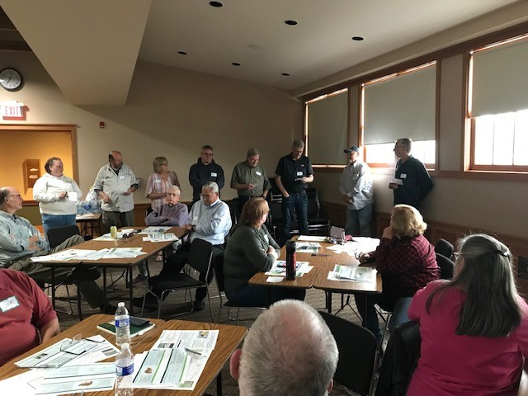
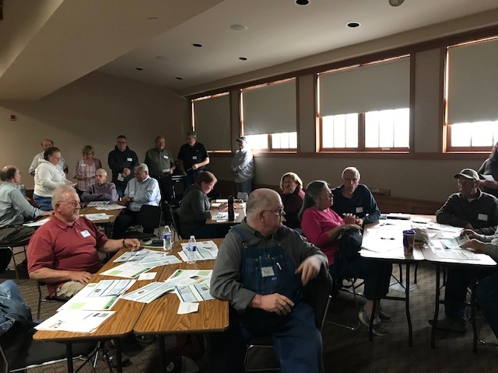

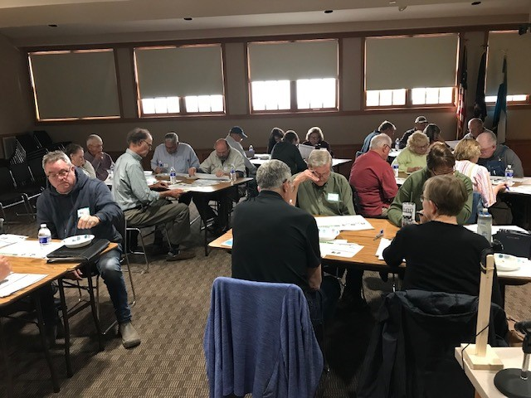
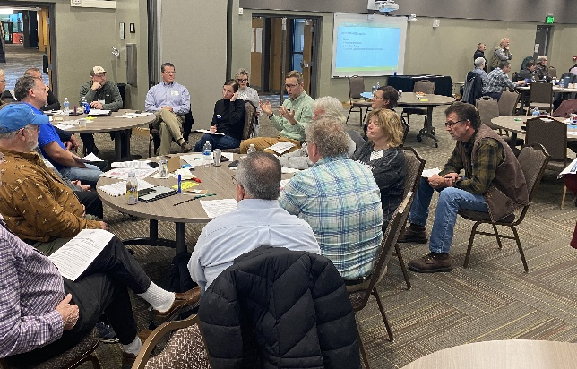

FOSTERING STRONG COMMUNITIES
GOVERNMENT, PUBLIC POLICY & LAND USE
CITIZEN PLANNER
MSU Extension brought the award-winning Citizen Planner program to Manistee County and 20 participants, representing nine municipalities attended. The comprehensive planning and zoning certificate program was delivered via three-hour in-person sessions over six weeks. Brown Township hosted the event, providing a central location to County residents.
SITE PLAN REVIEW
This 2-hour site plan review training was presented to the City of Manistee Planning Commission by Government and Public Policy Educator, Mary Reilly. Participants built their skills by reviewing real site plans and working through scenarios.
RENEWABLE ENERGY
Act 233 brought changes to renewable energy permitting in Michigan, including an option for state-level land use permitting for utility-scale projects. MSU Extension provides programming designed to help communities weigh the pros and cons of various regulatory options and build capacity for decision making.
ZONING ADMINISTRATOR CERTIFICATE PROGRAM
Over the last two years, the entire staff of the Manistee County Planning department attended the Zoning Administrator Certificate (ZAC) program. ZAC is an in-depth, highly specialized program helping zoning administrators understand their job effectively while reducing legal risk. A certificate is earned by completing 18 hours of training and passing a rigorous exam.
NEW COMMISSIONER SCHOOL
New Commissioner School (NCS) 2024 provided fundamental education for new and veteran county commissioners. The program helped participants explore governance complexities, understand their roles, learn about county finance, and develop strategies for effective decision-making and collaboration. The 2024 NCS included self-paced online modules or live webinars in November, followed by full day in-person workshops in December. One new commissioner from Manistee attended NCS in 2024.
GOVERNING ESSENTIALS
Governing Essentials is a three-part webinar series including Open Meetings Act, Parliamentary Procedures, and Components of Extraordinary Boards. A handful of Manistee County residents participated in this course and interest in board training is on the rise. This series (or parts of it) could be offered locally.
“I plan to use what I learned regarding the Master Plan process next year when we begin updating our plan.”
“What we learned will have an ongoing impact on the decision process for our citizens. I also believe that it will normalize fairness in the decision making between townships. “
- Citizen Planner attendees

Slide 8
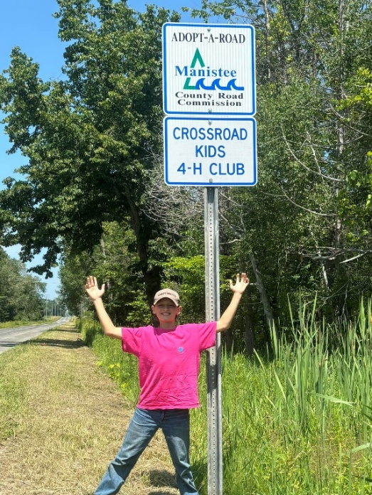
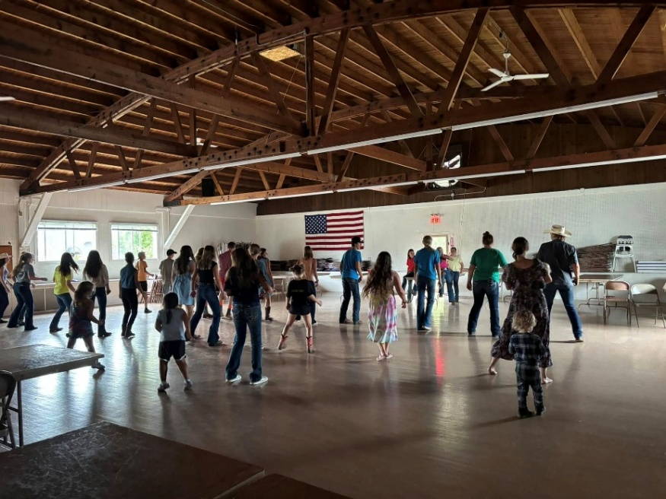
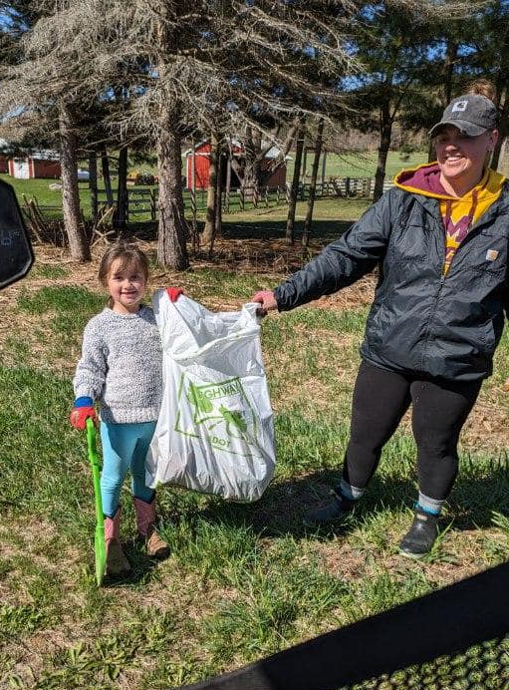
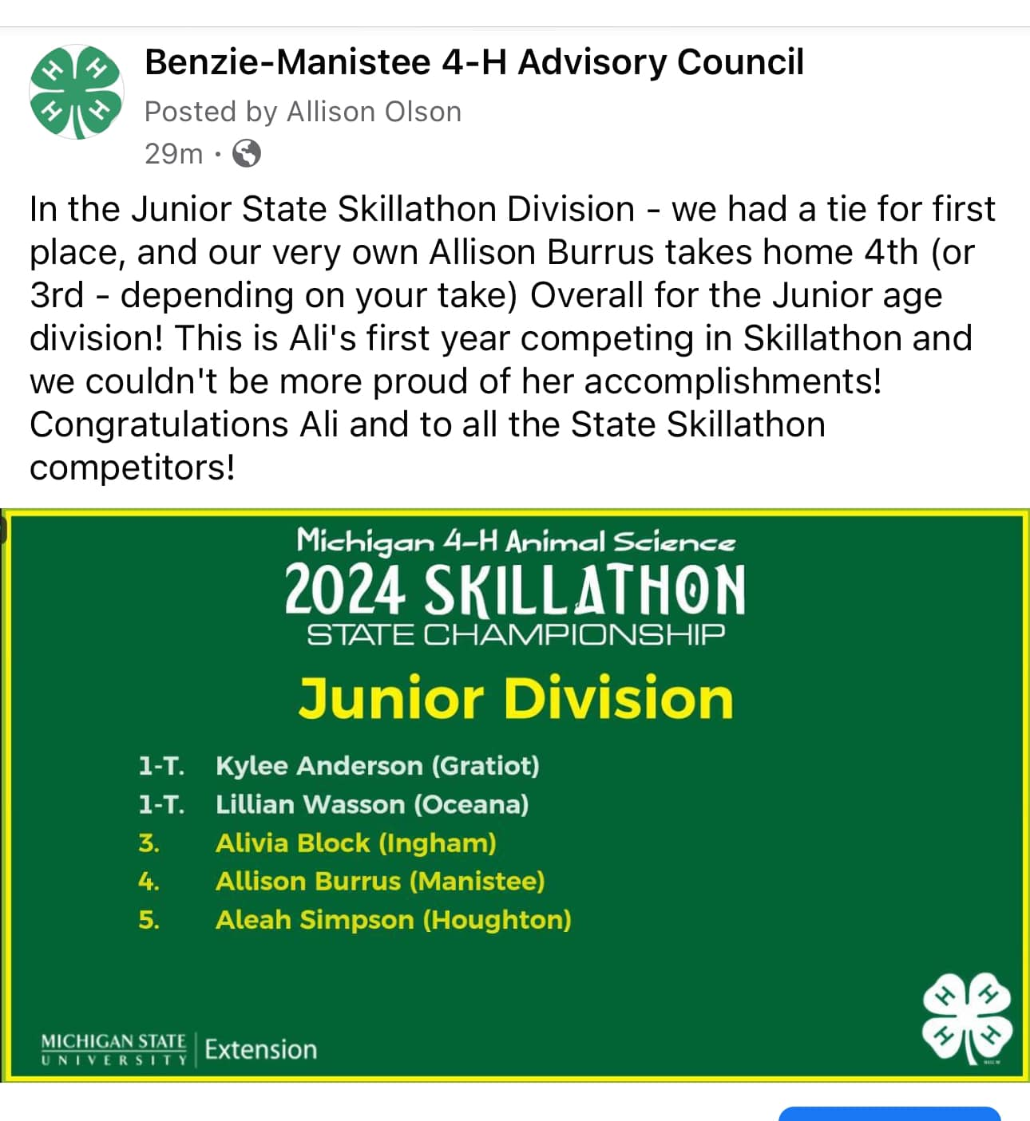

DEVELOPING YOUTH AND COMMUNITIES
4-H PROGRAM
NEW PARTNERSHIPS = NEW PROGRAMS
Kathryn Borowicz, Environmental Educator with the Manistee Conservation District, recently reached out to learn more about current 4-H youth development and educational initiatives in Manistee County. Kathryn brings valuable experience to the table—she coordinates numerous field trips for youth throughout the early summer and fall, holds a Michigan teaching certificate, and is certified to teach Project WILD through the Department of Natural Resources (DNR). She also has established relationships with Onekama Consolidated Schools and a strong understanding of local government education.
A natural opportunity for collaboration was identified through the 3rd-grade life cycle curriculum in the spring, where embryology aligns well. Kathryn and Allison Ballard have existing connections at Kaleva Norman Dickson (KND) and Onekama schools, respectively. The two worked together to plan a spring program focused on embryology. In total, three 3rd-grade classrooms participated using curriculum aligned with Agriculture in the Classroom. Eggs were provided by WanderWood Farms in Lake Ann. Students had the opportunity to adopt chicks to raise at home – all of them were adopted which is a testament to how popular the program was! Participating students also had the chance to tour the farm as part of the experiential learning process. This partnership between the Manistee Conservation District and Manistee 4-H is already planning ahead for winter programming to include events such as Nature @ Night. This program will serve as a seasonal complement to the spring embryology project. This event will feature educational components, three – four interactive stations, and a campfire s’mores treat for participants.
Other programming opportunities include partnering with the Manistee Library Story Park to explore the possibility of incorporating a food forest into their landscaping plan and offering youth paddle sports. We’re excited about these collaborative efforts and the opportunity to expand meaningful, hands-on learning experiences for youth in Manistee County.
COMMUNITY SERVICE PROJECTS
Two 4-H clubs, Northwoods Kids and Crossroad Kids, were involved in Adopt-A-Highway programs. Crossroad Kids also helped with collecting donations for Hurricane Helene Relief. The Southline Eager Beavers scraped paint and repainted playground equipment at the Claybank Park in Stronach Township.

Slide 9
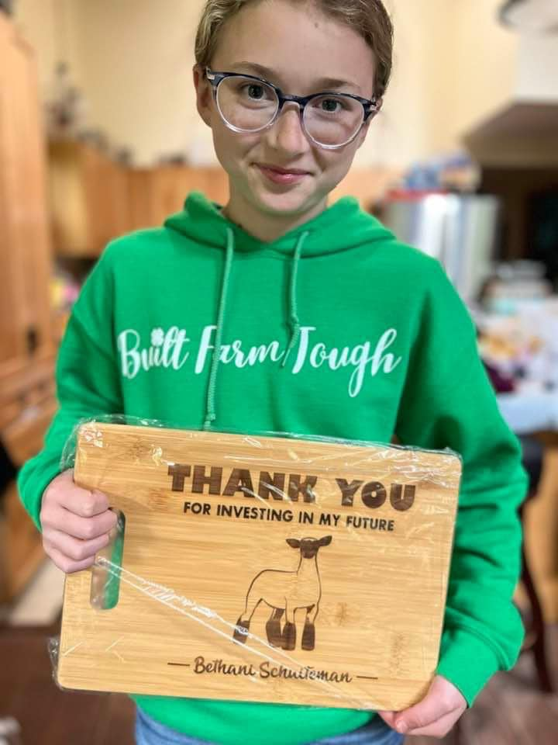
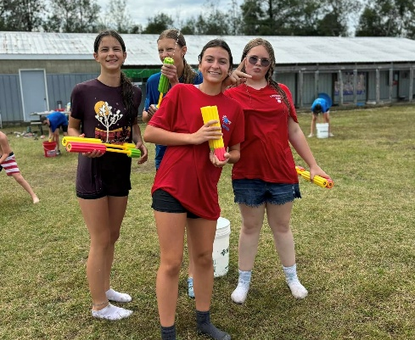
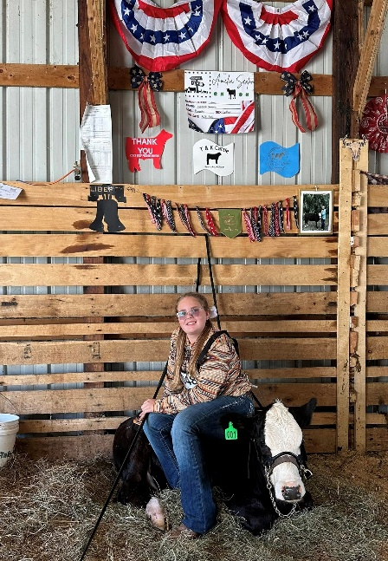
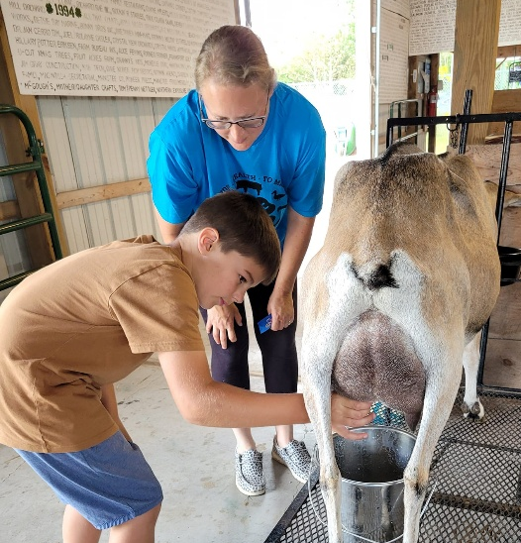
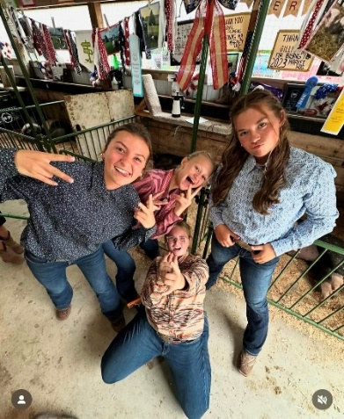
DEVELOPING YOUTH AND COMMUNITIES
4-H PROGRAM
67 Youth Auction Participants
Total Sales: $161,964.53 (includes donations and resale)
Total Amount of Checks paid to Livestock Youth: $143,574.58
ANNUAL KALEVA NORMAN DICKSON SCHOOLS CAREER FAIR
The KND K–12 Career Fair has become a cornerstone of Manistee County 4-H’s outreach efforts in recent years. Held annually, this event provides a valuable opportunity to engage with youth across all grade levels, promote 4-H programs, and spark meaningful conversations about future career paths. Strategically timed in the spring, the fair is particularly effective for introducing older students to statewide pre-college experiences such as 4-H Animal & Veterinary Science Camp and 4-H Exploration Days.
This year’s event was no exception. The 4-H booth drew significant interest from students exploring a wide range of career paths – including equine science, pre-veterinary and pre-med tracks, education, psychology, art, media, and more. However, one interaction stood out.
A junior student approached the 4-H table with a group of friends and when asked about her interests, she shared that she was passionate about digital art and media but felt uncertain about post-secondary opportunities due to limited access in the region. After hearing about her interests, 4-H Exploration Days was suggested. This is a three-day pre-college program hosted on the MSU campus. The student lit up with excitement, but it quickly turned to disappointment upon learning the program cost of $220. The student quietly said, “My family can’t afford that,” and attempted to return the informational flyer. When told that full scholarship funding was available and could cover the entire cost of the program. The shift in her demeanor was immediate – her eyes once again full of hope.
She was encouraged to take the flyer home, speak with her parents, and email the 4-H office to confirm interest. The student returned to the table multiple times throughout the event, seeking reassurance that the scholarship opportunity was real. The final message she received was simple but heartfelt: "If your parents say yes, and you send me an email confirming that, you will attend 4-H Exploration Days at absolutely no cost to you.“
This interaction serves as a powerful reminder of the impact that 4-H can have when access barriers are removed and students are supported with real opportunities. We sincerely hope this young person takes that next step.
MANISTEE COUNTY FAIR
The animal barns at the fairgrounds were busting at the seams again this year, with another record year of fair entries.
There were a couple of new events added to the schedule in 2024. There was a barn dance, where the 4-H kids could cut a rug and do some boot-scootin’ to blow off some stress from the showring! The kids also got to cool off with a water war. Another fun event turned the tables, and it was the parents’ turn to enter the show ring, as the kids got to judge their showmanship skills.

Slide 10
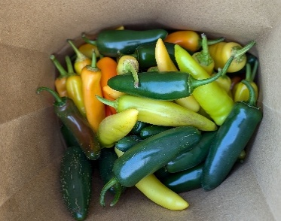

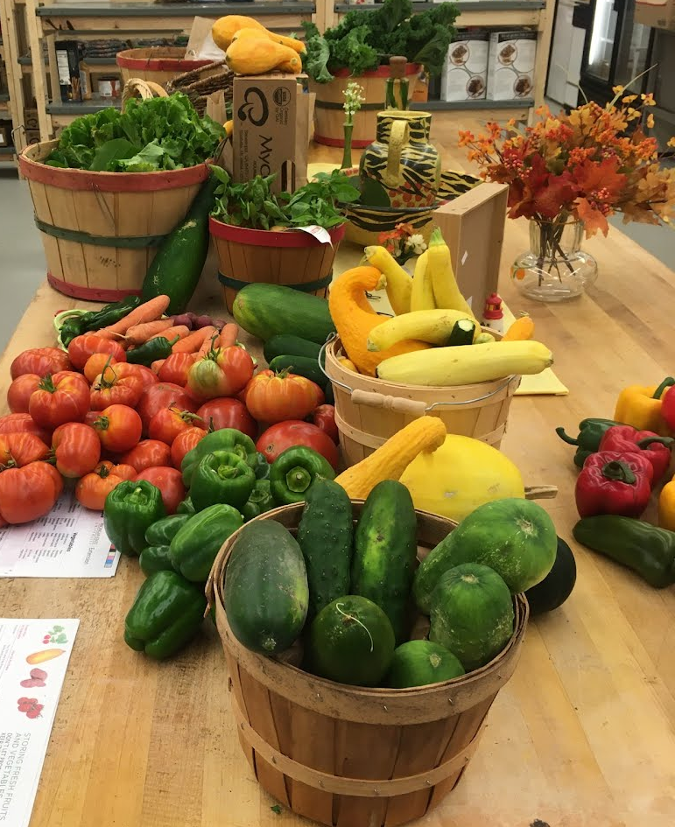
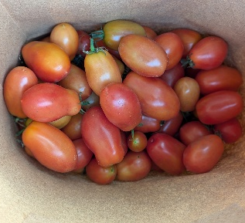

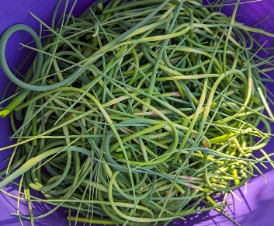

KEEPING PEOPLE HEALTHY AND ENSURING SAFE FOOD
SNAP-ED PROGRAM
446 pounds of fresh produce donated
370 households benefited from garden donations
FOOD ACCESS STRATEGY TEAM (FAST) – FOOD PANTRY ASSISTANCE
The Food Access Strategy Team, or FAST, is a subcommittee of the LiveWell 4 Health Manistee coalition. The goal of this group is to strengthen the Manistee County food support system for those in need. This work is done by improving coordination of county food pantry efforts and improving accessibility of healthy food to those who need it. In 2022, FAST distributed a county-wide survey to gauge feedback about food access from Manistee County residents in hopes of better understanding what barriers people face in accessing food. We continue to use the results of the survey to direct our work and improve access to fresh fruits and vegetables.
GROW A ROW
A new program where Manistee County gardeners are asked to grow an extra row – or plant – of fruits or vegetables to donate to area food pantries. This allows folks who are experiencing food insecurity and visiting food pantries to choose healthy food options such as fresh fruits and vegetables. This is a partnership between FAST, MSU Extension, and the Spirit of the Woods Garden Club.
They plan to continue this program in 2025 with a goal of getting 600 pounds of garden-grown produce donated.
FIELD 2 PANTRY
This is the second year of the Field 2 Pantry program where pantries purchase directly from local farms. In 2024, FAST sponsored a coordinator position to facilitate the process.
This program has been great in developing good neighbor relationships between farmers and community. Approximately 200 families benefited from the Field to Pantry pilot program. Nearly $1,700.00 was spent on produce purchases from local farms.
“Offering fresh produce is always a goal of our pantry. We like to see people selecting healthier choices such as potatoes, carrots, onions, zucchini, green beans, and apples.”
-Melanie Gill, ECHO His Love: MANNA Food Pantry

Slide 11
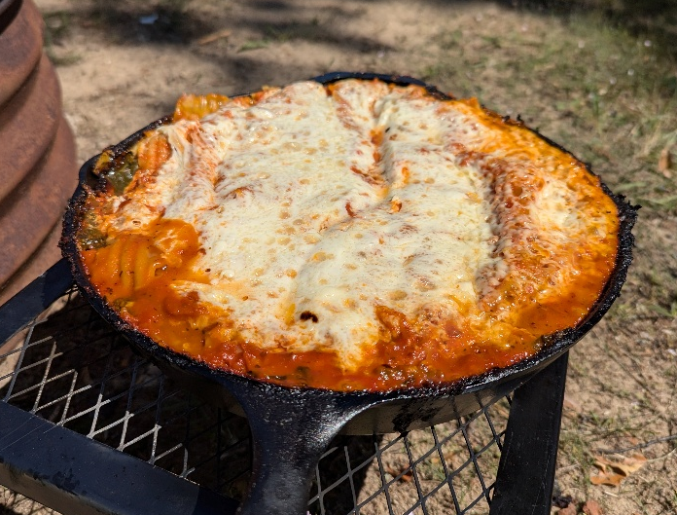
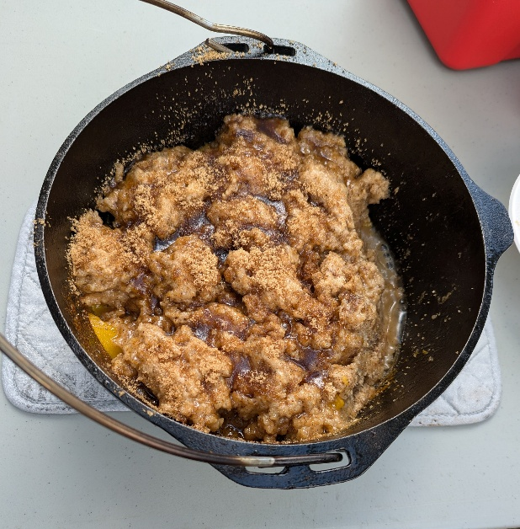
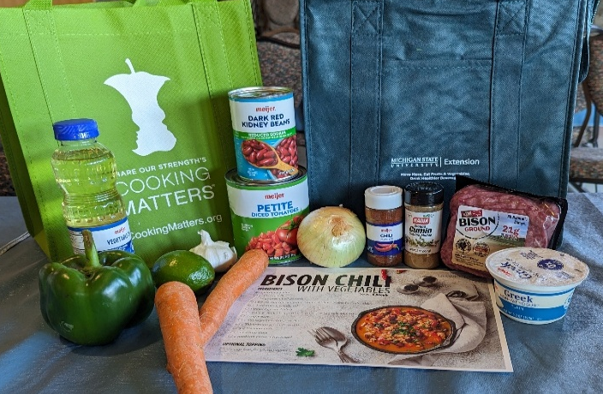
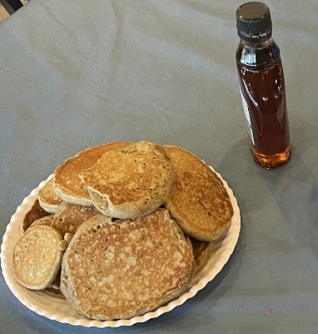
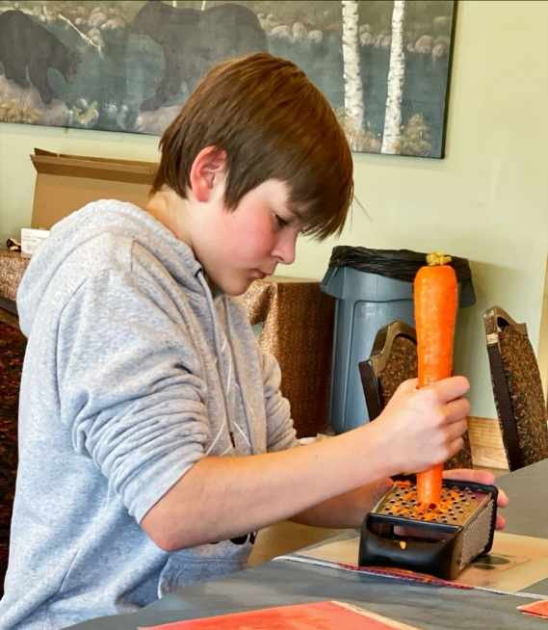
KEEPING PEOPLE HEALTHY AND ENSURING SAFE FOOD
SNAP-ED PROGRAM
LITTLE RIVER BAND OF OTTAWA INDIANS (LRBOI)
COOKING CLASSES TO HEALTHY CHANGES
Policy, system, and environmental changes are a way of making sustainable changes within our community, so healthy choices are easier to access. These changes help to improve places where people live, learn, work, play, eat, and worship. MSU Extension works closely with area partners to help write guidelines, alter the way things are done, and improve spaces so all people can be supported in leading a healthy life.
ELDERS MEAL PROGRAM
MSU Extension held seven direct education classes with Tribal Elders during lunches, using the Cooking for One curriculum which aims to help people living on their own or in small families learn how to budget, shop, and cook for smaller meals.
The group was coached by MSU Extension to help increase physical activity options for Elders. They worked towards decreasing falls, building muscle, and restoring balance.
They were awarded a mini grant sponsored by MSU Extension to purchase small fitness equipment to aid Elders in daily movement. As a result, the Elders are learning how to use equipment and are more active!
LRBOI COOKING CLASSES
MSU Extension hosted community cooking classes at Aki Maadiziwin Community Center and LRBOI Gathering Grounds campground. Participants earned healthy cooking over a campfire – this series was geared towards folks who were experiencing homelessness and living at the campground on the reservation. Recipes featured used foods that were available at the Food and Nutrition Center (otherwise known as the Food Distribution Program on Indian Reservation – FDPIR). These classes were taught in partnership with the LRBOI Food and Nutrition Center and Family Spirit Services.
“This has been so helpful!”
–LRBOI Elder regarding equipment and coaching
“I used to do a bunch of things – I was always moving. Then, I fell and couldn’t do as much anymore. But I can start again, a little bit at a time.” -LRBOI Elder

Slide 12
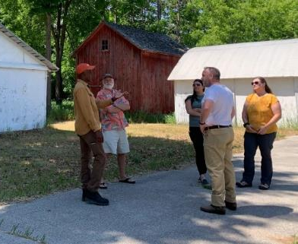

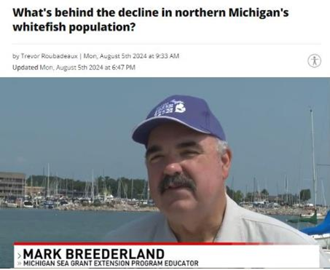
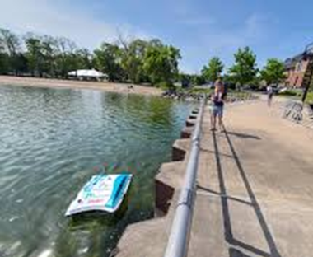
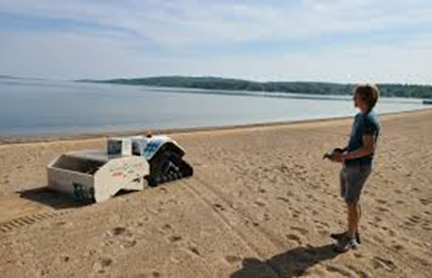
FOSTERING STRONG COMMUNITIES
PRODUCT CENTER
SEAGRANT
PRODUCT CENTER
IMPACTS IN
MANISTEE COUNTY
2 businesses
2 counseling hours
Over $100,000 in annual sales
(combined)
26 total employees
MSU PRODUCT CENTER BUSINESS DEVELOPMENT
The Michigan State University Product Center supports entrepreneurs in Northwest Michigan who are launching or growing businesses in food and agriculture. From farm-based products to value-added goods, the center provides expert guidance through business planning, market research and feasibility analysis.
Through its Traverse City-based innovation counselor, the Product Center offers personalized guidance to help local entrepreneurs turn ideas into viable products and services.
By fostering local business development, the Product Center plays a key role in strengthening the regional economy and building a resilient, community-based food system.
CONNECTING ENTREPRENEURIAL COMMUNITIES CONFERENCE
Held May 30-31, 2024 in Cadillac, the annual Connecting Entrepreneurial Communities (CEC) Conference brought together 111 attendees from across the state, including 21 from Northwest Michigan, to explore strategies for building resilient local economies.
Designed to support chambers of commerce, downtown development authorities, municipal leaders, and economic development professionals, the conference focused on practical approaches for strengthening entrepreneurial ecosystems through community collaboration and place-based innovation.
SEA GRANT
In 2024, the Michigan Sea Grant Extension program continued its mission to deliver high-impact outreach and education, supporting Great Lakes stewardship across coastal communities—including Manistee County and the surrounding region. With its mission to bring science to the shoreline, Michigan Sea Grant led a variety of initiatives focused on environmental resilience, water quality, and sustainable use of Great Lakes resources.
A key highlight of the year was the Freshwater Summit, held in October of 2024, where over 85 people gathered for a full day of presentations and dialogue on critical regional water issues. Topics included Grand Traverse Bay fisheries and ongoing Lake Whitefish restoration, updates on the FishPass project at Union Street Dam, and a broader view of Great Lakes ecosystem challenges. The event provided a valuable opportunity for local leaders, researchers, and residents to engage with cutting-edge science and policy developments.
Sea Grant also advanced its work on shoreline stewardship and marina sustainability, including support for the Clean Marinas Program. This included the use of innovative tools like the PixieDrone and BeBot beach robot, which help remove macroplastics from beaches before they break down into harmful microplastics. These efforts directly support cleaner, healthier recreational and working waterfronts.
In addition to public events and field work, Sea Grant Extension professionals were a trusted resource for local residents, answering questions on a wide range of topics from invasive species and boat wash stations to fluctuating lake levels, erosion, fisheries trends, and resilient shoreline development. These efforts ensure that Great Lakes communities, including those in Manistee County, have access to the best available science and practical guidance to support sustainable, thriving shorelines.
BEBOT & PIXIE DRONE

Slide 13

STAFF HOUSED IN MANISTEE COUNTY
NAME ROLE PHONE EMAIL
Jennifer Berkey District Director 231-922-4821 berkeyj@msu.edu
Mary Reilly Government & Public Policy 231-889-4277x1 reillym8@msu.edu
Allison Ballard 4-H Program Coordinator 231-889-4277x3 olsonal8@msu.edu
Sherry Stamp Office Manager 231-889-4277x5 stamp1@msu.edu
MSU EXTENSION STAFF SERVING MANISTEE COUNTY
Chris Bardenhagen Farm Business Management 231-256-9888 bardenh1@msu.edu
Terra Bogart Supervising & Staff Development 231-922-4630 bogartte@msu.edu
Mark Breederland Sea Grant & Coastal Communities Devt. 231-922-4628 breederl@msu.edu
Sam Bailey Community Prosperity 231-582-6482 baile485@msu.edu
Julie Crick Forestry & Natural Resources 989-275-7179 crickjul@msu.edu
Christina Curell Cover Crop & Soil Health 231-745-2732 curellc@msu.edu
Mary Dunckel Agriculture Literacy 989-354-9875 dunckelm@msu.edu
Phillip Durst Beef 989-345-0692 durstp@msu.edu
Sarah Eichberger Public Health Interventions 231-922-4836 eichber2@msu.edu
Charles Gould Bioenergy & Conservation 616-994-4547 gouldm@msu.edu
Tom Guthrie Equine 517-788-4292 guthril9@msu.edu
Parker Jones Product Center Innovation Counseling 231-922-4621 jonesp28@msu.edu
Philip Kaatz Forage/Commercial Agriculture 810-667-0341 kaatz@msu.edu
Heidi Lindberg Greenhouse & Nursery 616-994-4701 wollaege@msu.edu
Erin Lizotte Integrated Pest Management 231-944-6504 taylo548@msu.edu
Kara Lynch Food Safety 989-317-4079 lynchka4@msu.edu
Michael Metzger Small Ruminants & Foragers 517-788-4292 metzgerm@msu.edu
Esmail Nasrollahiazar Wine Grapes 231-256-9888 nasroll2@msu.edu
Dennis Pennington Wheat Systems 269-832-0497 pennin34@msu.edu
Emily Proctor Tribal Governance 231-439-8927 proctor8@msu.edu
Bethany Prykucki Leadership & Community Engagement 231-258-3320 prykucki@msu.edu
Remington Rice Health & Farm Stress Educator 231-882-0025 riceremi@msu.edu
Nikki Rothwell Commercial Fruit 231-946-1510 rothwell3@msu.edu
J Robert Sirrine Community Food Systems/Hops 231-256-9888 sirrine@msu.edu
Nate Walton Home Horticulture/Master Gardener 231-256-9888 waltonn2@msu.edu
Benjamin Werling Vegetable Crop Production 231-873-2129 werlingb@msu.edu
Wendy Wieland Product Center Innovation Counselling 231-348-1770 wieland5@msu.edu
Samantha Wolfe Agriculture & Occupational Health 231-882-0025 wolfesa4@msu.edu
Casey Zangaro Swine 989-872-5292 zangaroc@msu.edu

